Slide 1
Digital Numbers
The Remote Sensing world calls cell values are also called a digital number or DN.
In most of the imagery we work with the DN represents the strength of the signal (amount of light) that is assigned to each grid cell (pixel).
  Low or None - Lowest DN (0 is at bottom of scale)
  High - Maximum value (depends on radiometric resolution)
  Others - Scaled in between (number of possible increments depends on radiometric resolution)

Slide 2
Landsat 8 Bands
Band | Wavelength | Useful for mapping
Band 1 – coastal aerosol | 0.43-0.45 | Coastal and aerosol studies
Band 2 – blue | 0.45-0.51 | Bathymetric mapping, distinguishing soil from vegetation and deciduous from coniferous vegetation
Band 3 - green | 0.53-0.59 | Emphasizes peak vegetation, which is useful for assessing plant vigor
Band 4 - red | 0.64-0.67 | Discriminates vegetation slopes
Band 5 - Near Infrared (NIR) | 085.-0.88 | Emphasizes biomass content and shorelines
Band 6 - Short-wave Infrared | 1.57-1.65 | Discriminates moisture content of soil and vegetation; penetrates thin clouds
Band 7 - Short-wave Infrared | 2.11-2.29 | Improved moisture content of soil and vegetation and thin cloud penetration
Band 8 - Panchromatic | .50-.68 | 15 meter resolution, sharper image definition
Band 9 – Cirrus | 1.36 -1.38 | Improved detection of cirrus cloud contamination
Band 10 – TIRS 1 | 10.60 – 11.19 | 100 meter resolution, thermal mapping and estimated soil moisture
Band 11 – TIRS 2 | 11.5-12.51 | 100 meter resolution, Improved thermal mapping and estimated soil moisture

Slide 3
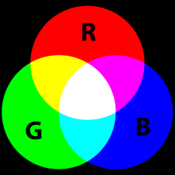
Problem
The human eye sees only Red, Green, and Blue
  And various shades of gray
How do we examine other spectral values?
  Computer monitor uses red, green, and blue to create color images
  You assign your choice of satellite band to each primary color
  Brightness of each color is determined by each pixel value in each band
  Result is a color image with each pixel’s color determined by combination of RGB of different brightness.

Slide 4
Assigning Bands to Primary Colors
Computer monitor uses red, green, and blue to create color images
You assign your choice of satellite band to each primary color
Brightness of each color is determined by each pixel value in each band
Result is a color image with each pixel’s color determined by combination of RGB of different brightness.

Slide 5
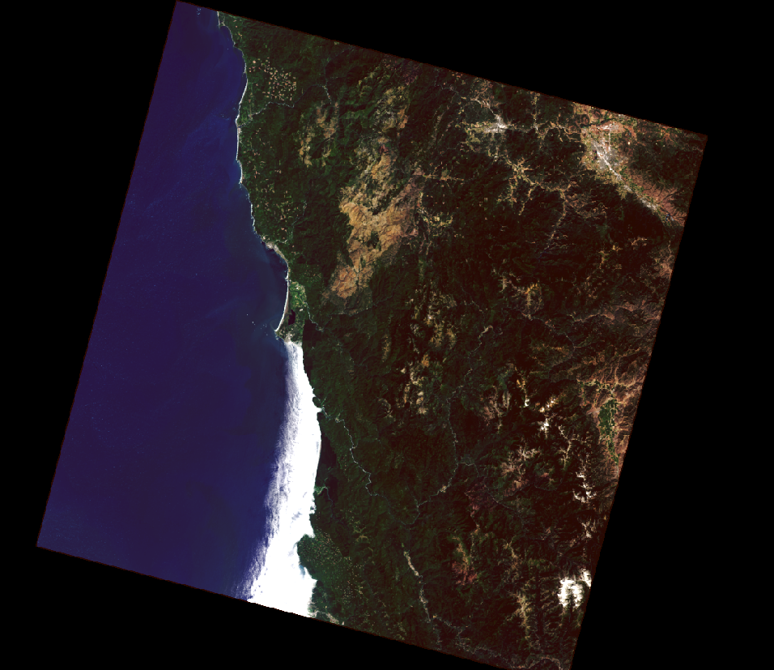
True Color Composite

Slide 6
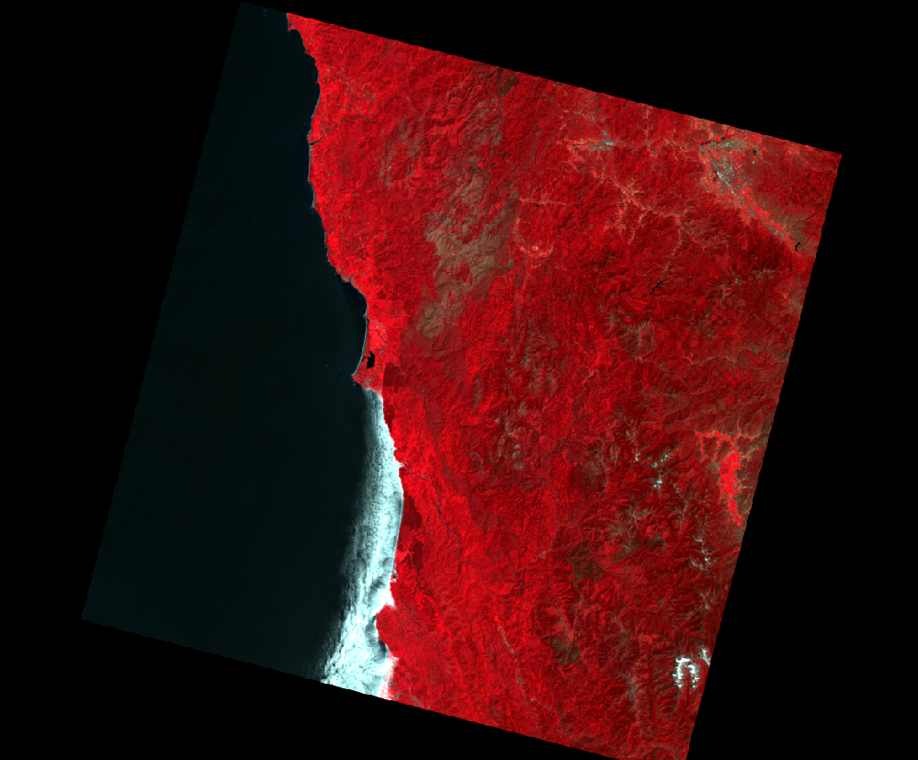
False Color Composite

Slide 7
Image Bands
False Color Composite:
Any other band combination other than true color: NIR color composite
Near Infrared Band – Red Channel
Red Band– Green Channel
Green Band – Blue Channel
Together they form a false color composite

Slide 8
Satellite Data Spatial Resolution
MODIS: 250 - 1000 m
Landsat MSS: 80 m
Landsat 5, 7, 8: 30 m (15 m panchromatic)
SPOT: 20 m
ASTER: 15m
Digital Globe 0.4 m (0.3m new)

Slide 9
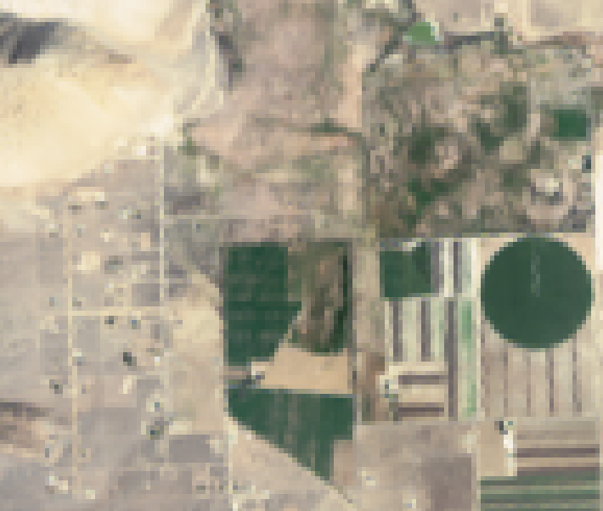

Spatial Resolution
Landsat 8: 30 m
30 m
30 m
Each Landsat 8 pixel is 30m x 30m or 900m²

Slide 10
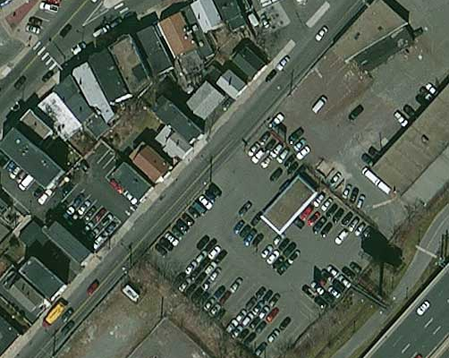
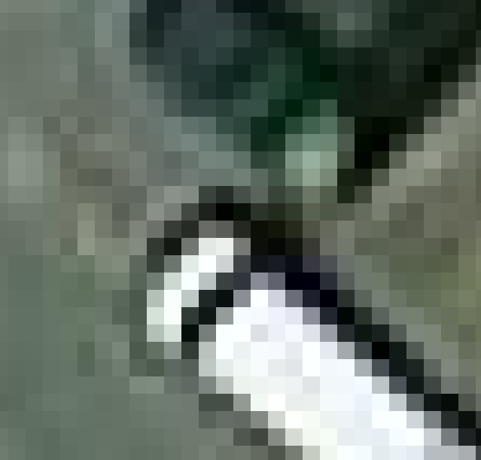
Spatial Resolution
WorldView 3 (DigitalGlobe):
0.4 (0.3) m
0.4 m
0.4 m
Each WorldView-3 pixel is 0.4m x 0.4m or 0.16m²

Slide 11
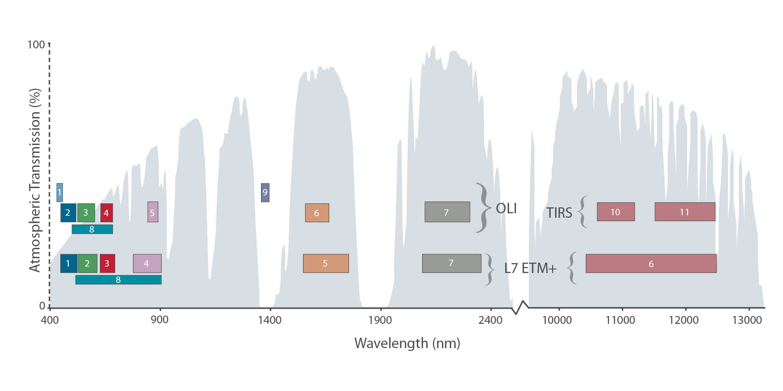
Landsat Spectral Resolution

Slide 12
Temporal resolution
Time between two subsequent data
acquisitions for an area or “return time”
    All of the Landsat satellites have a 16-day return time
    MODIS has a 1-2 day return time.

Slide 13
Return Time
(Temporal Resolution)
Depends on:
  Orbital characteristics
  Swath width
  Ability to point the sensor

